Slide 1

ROAD SIGNS DETECTION
PRESENTATION

Slide 2
PRESENTATION OUTLINE
Introduction
Methodology
Dataset Overview
Data Preprocessing Steps
Machine Learning Algorithms Used
Evaluation metrics
Model performance Results

Slide 3
INTRODUCTION
The Road Signs Detection System aims to enhance autonomous driving and smart city infrastructure by accurately identifying road signs from images. The motivation stems from the need for real-time, reliable detection of traffic signs to ensure road safety and assist driver decision-making. Traditional object detection methods often struggle with visually similar signs, particularly directional ones.
This project builds on advancements in deep learning, particularly YOLO (You Only Look Once) for object detection and Convolutional Neural Networks (CNNs) for image classification. By combining these two models, we enhance both the localization and identification stages in the detection pipeline. The hybrid method significantly improves classification accuracy over using YOLO or CNN alone.

Slide 4
DATASET OVERVIEW
01
02
DATASET COMPOSITION
DATA SET SOURCE
The dataset used comprises approximately 1,200 labeled images, including three categories: Stop, Left Turn, and Right Turn signs.
Images were sourced from public datasets and manual collection efforts like roboflow.

Slide 5
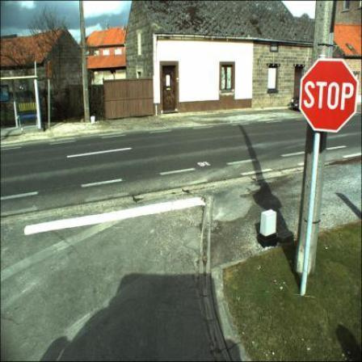
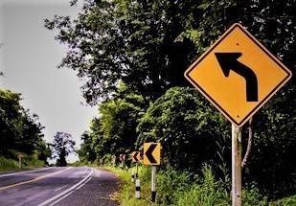
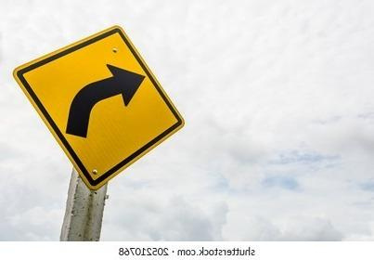
0
0.9084821428571429
0.2622767857142857
0.16294642857142858
0.203125
1
0.7993527508090615
0.36046511627906974
0.37540453074433655
0.5162790697674419
1
0.2630272952853598
0.42142857142857143
0.4665012406947891
0.6642857142857143

Slide 6
DATA PREPROCESSING STEPS
Data augmentation
auto cropping
Data Splitting
The dataset were augmented using ROBOFLOW + from yolo model
after yolo predict the bounding boxes for the train dataset we crop the bounding boxes then send it to CNN to make classes prediction
The dataset was divided into (80%) training and (20%) validation subsets to evaluate model performance effectively.

Slide 7
METHEDOLOGY

Slide 8
INITIAL APPROACH
YOLOv8 Detection: We initially start with YOLOv8 for end-to-end detection and classification of road signs. While YOLOv8 performed well in identifying ‘Stop’ signs, it consistently failed to differentiate between ‘Left Turn’ and ‘Right Turn’.

Slide 9
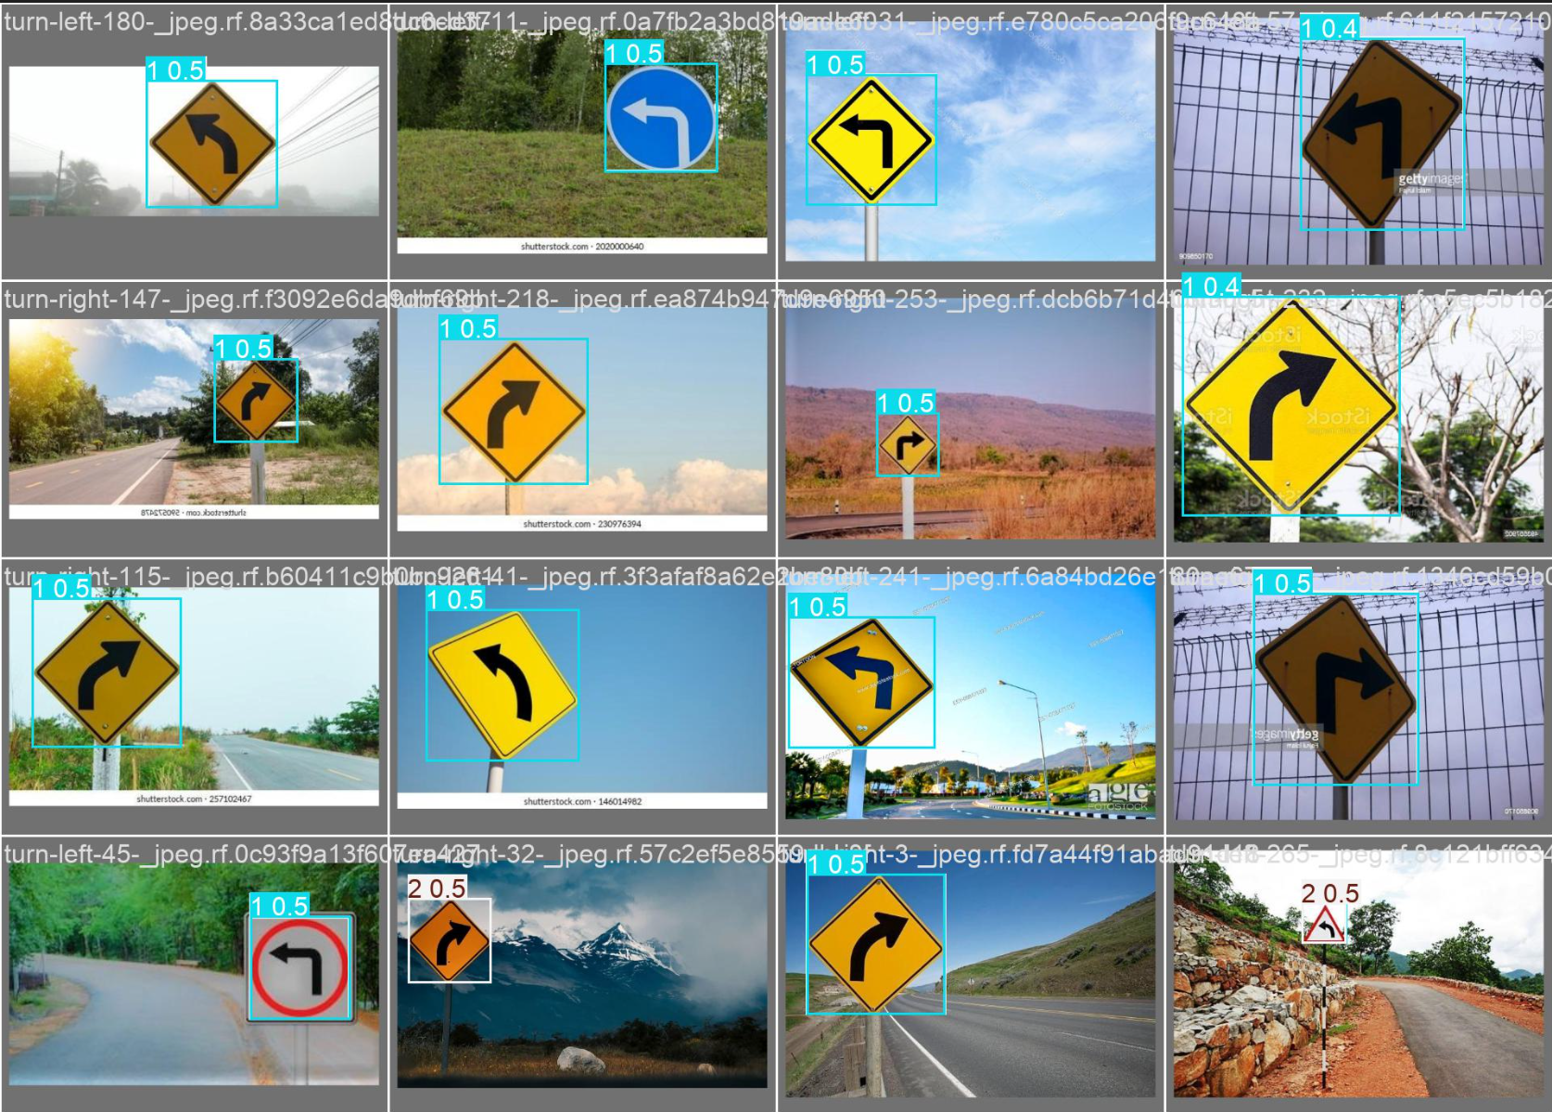

Slide 10
PROBLEM RESOLUTION STRATEGY
To solve this problem, we tried 2 attempts:
We first attempted to improve YOLO’s classification through traditional data augmentation using built-in YOLO augmentation settings.
CNN-Based Classification on YOLO Crops (Effective)

Slide 11
FINAL INTEGRATED SYSTEM
In the final solution, YOLOv8 handles object localization, while CNN handles directional classification. So, we made two stages solution for this main problem. first stage will be YOLO predictions and second stage CNN classification, so these two models were integrated into a single pipeline that performs

Slide 12
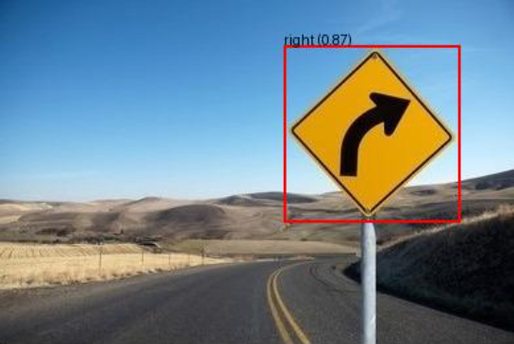
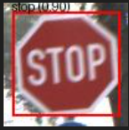
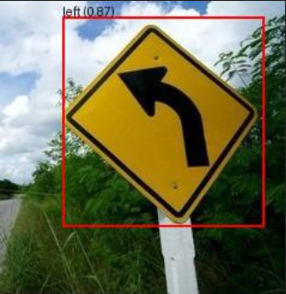

Slide 13
CNN ARCHITECTURE (RESNET18-BASED)
Input: 224×224 RGB images
Base Model: Pretrained ResNet18
Final Layer: Modified fully connected layer for 2-class output (Left/Right)
Activation Functions: ReLU (intermediate), Softmax (implied at output)
Optimizer: Adam (learning rate = 1e-4)
Training: 50 epochs with early stopping and learning rate scheduling

Slide 14
Evaluation Metrics
Accuracy
Recall
mAP@50
Precision
F1-Score
mAP@75

Slide 15
YOLO RESULTS

Slide 16
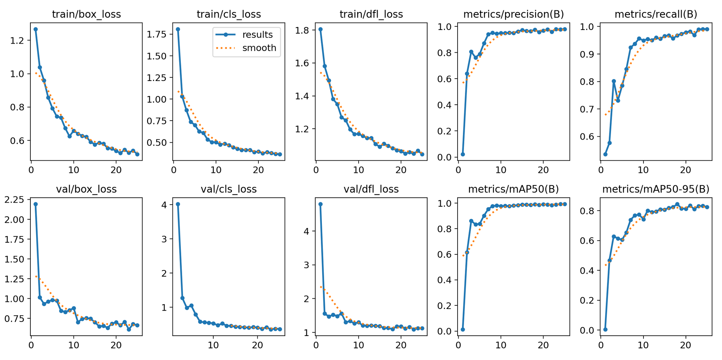

Slide 17
FINAL RESULTS
 | Accuracy | Precision | Recall | f1-score | mAP@50 | mAP@75
YOLO | --------- | 0.93 | 0.95 | stop : 0.92351 left_right : 0.96824 | 0.98368 | 0.96899
RESNET | 0.96 | 0.96 | 0.96 | 0.96 | ---------- | ----------
integrated | 0.99 | 0.99 | 0.99 | 0.99 | ---------- | 0.97899

Slide 18
CONFUSION MATRIX

Slide 19
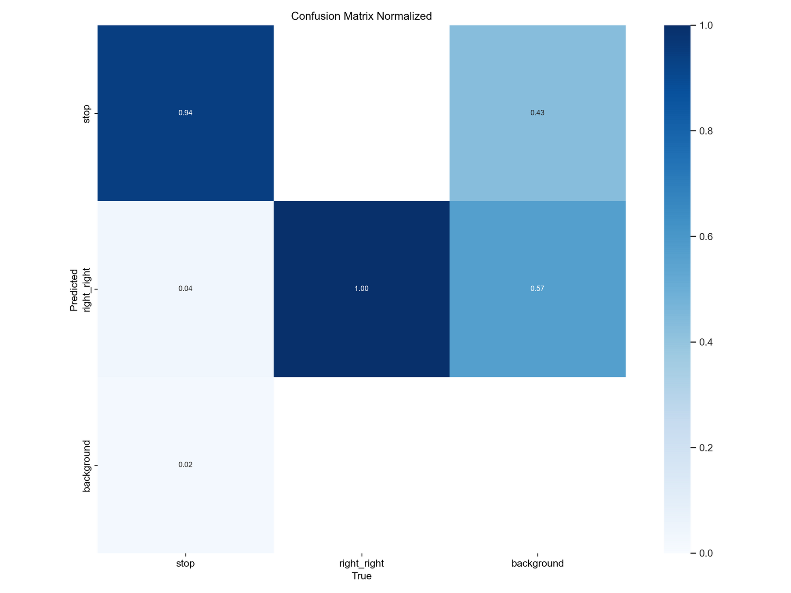
YOLO

Slide 20
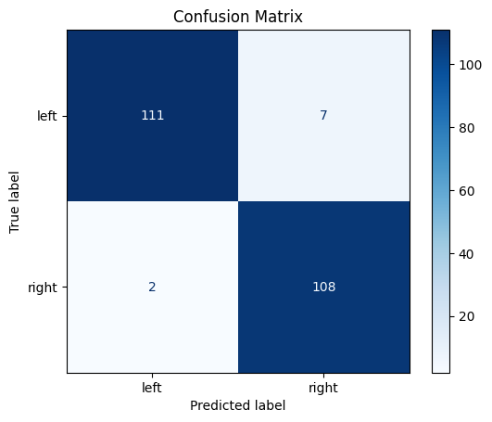
RESNET

Slide 21
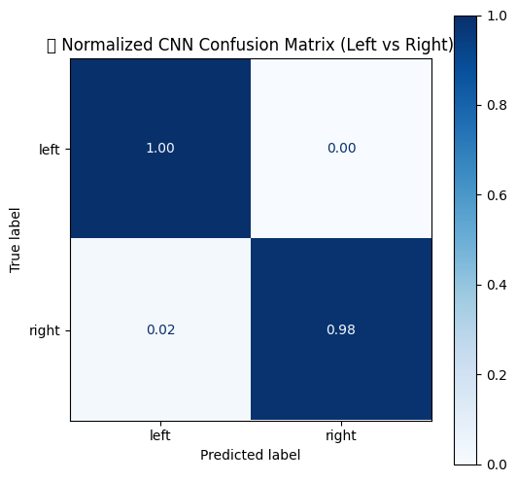
INTEGRATED

Slide 22
CONCLUSION
This project demonstrates a robust two-stage approach for road sign detection and classification. YOLOv8 efficiently detects road sign locations, while a custom CNN classifier accurately categorizes them, especially improving the detection of similar directional signs. This hybrid method addresses limitations in using YOLO alone for classification.

